Slide 1
Bioinformatics 101 Session 3 | High Performance Computing
Vijay Kumar
9/23/17

Slide 2
Outline
Introduction to High Performance Computing
Basic Commands
Run your first batch job on the cluster
Know and manage your job/process
Know your cluster
How to invoke modules (Python, R, samtools etc)?

Slide 3
High Performance Computing
Simplistic Definition: Multiple computers connected via a high performance network.
Terminologies:
Core | Basic Processing Unit
Processor | Usually a chip with one or more cores
Node | A self contained unit with ’n’ cores and disk space
Cluster | A network of processor nodes
Login Node | Nodes that facilitate interaction with compute nodes
Compute Node | Nodes where computations happen
Hierarchy: Core -> Processor -> Node -> Cluster
Modes:
Interactive - Often used to test sample code prior to running them as batch jobs
Batch - Supports batch processing via scheduling software that manages job queue

Slide 4
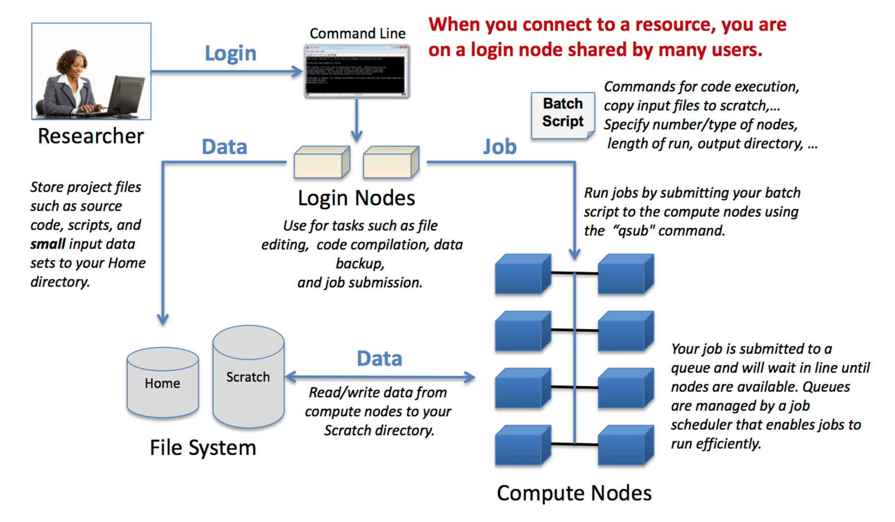
Running a job on the cluster
https://bluewaters.ncsa.illinois.edu/image/image_gallery?uuid=f66f5fb4-9d87-4e2d-8ad0-b22d1ec30d6b&groupId=10157&t=1386858420321

Slide 5
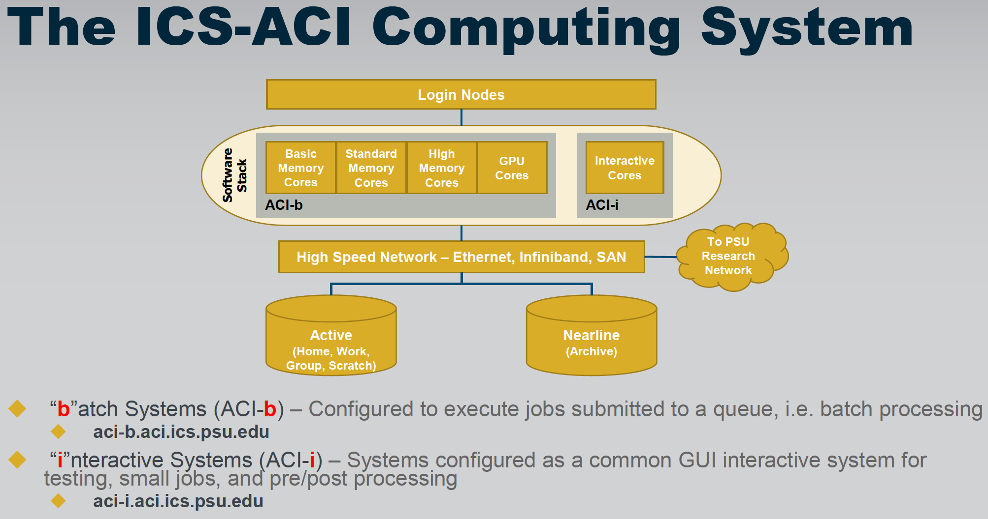
ICI - Penn State Cluster

Slide 6

ICS-ACI Cluster Specs

Slide 7

What a cluster is ‘really’ like

Slide 8
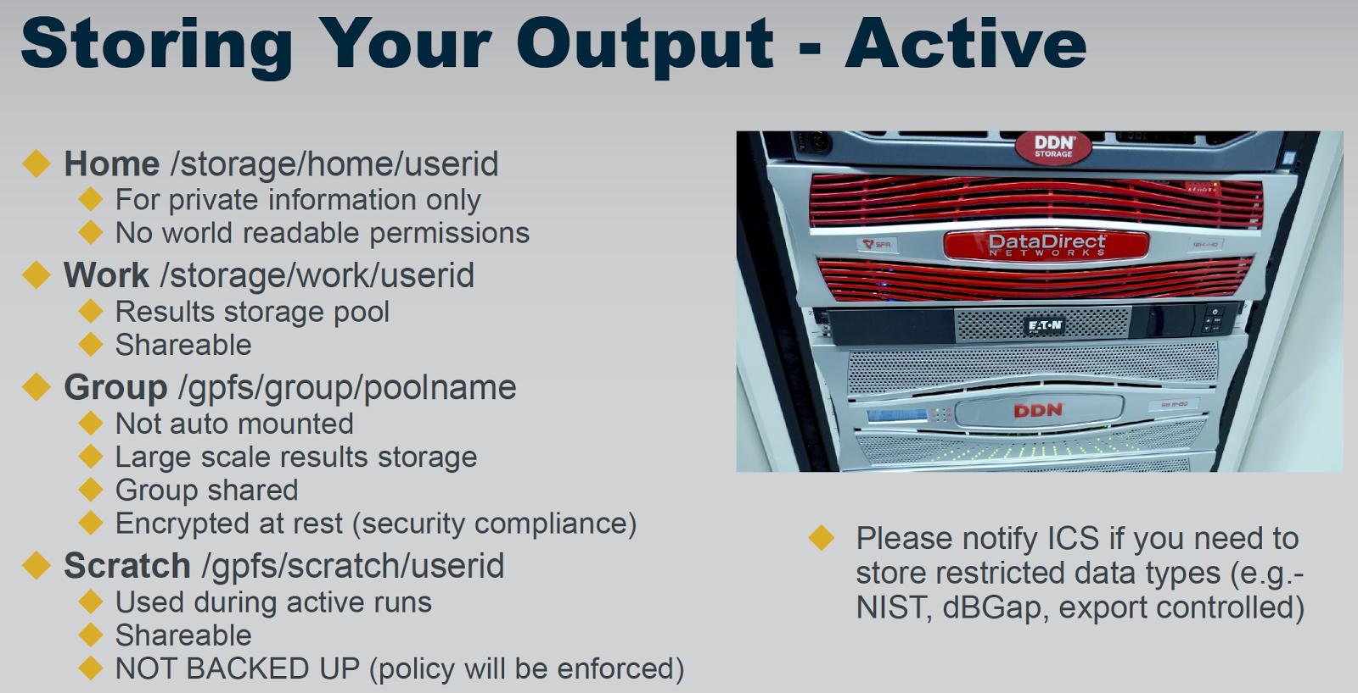
File Structure

Slide 9
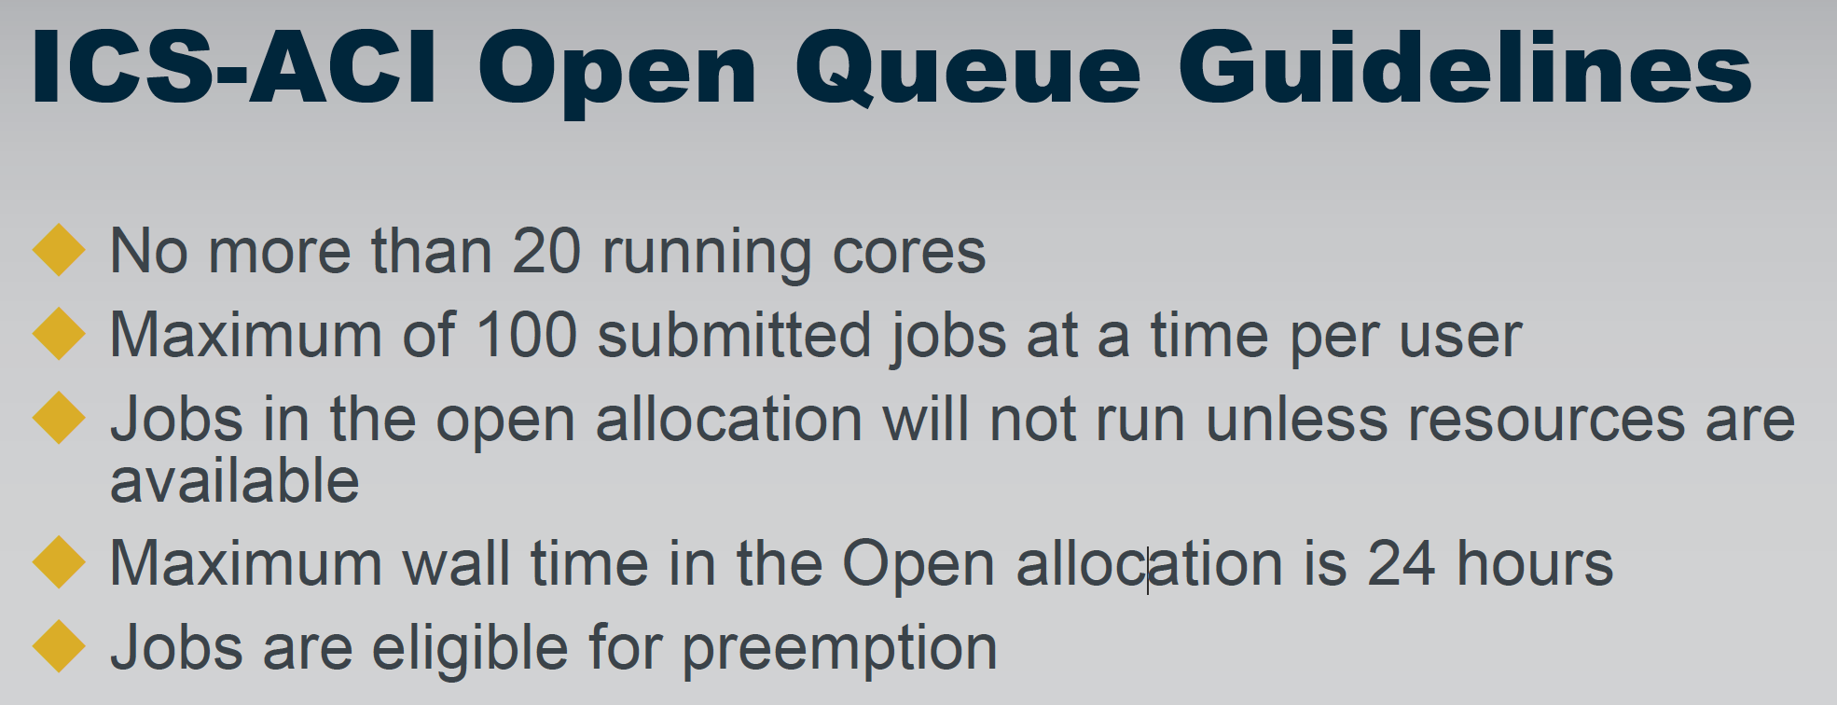
Open Queue Limits
https://ics.psu.edu/what-we-do/education-and-training/ics-demand-tutorial-videos/

Slide 10
Resources
Tutorials: https://ics.psu.edu/advanced-cyberinfrastructure/support/tutorials/
Training Videos: https://ics.psu.edu/what-we-do/education-and-training/ics-demand-tutorial-videos/
Seminars: ICS System Basics + Introduction to HPC
https://ics.psu.edu/what-we-do/education-and-training/ics-aci-training-series/
Supported Module List: https://ics.psu.edu/advanced-cyberinfrastructure/support/software/

Slide 11
Exercises

Slide 12
Task 1 : Run your first batch job

Slide 13
Task 1 : Run your first batch job
Step 1: Create a file named ‘first_batch_job.pbs’ using a text editor of your choice.
Step 2: Copy and paste the following code into the newly created file.
#!/bin/bash
# Remarks: A line beginning with # is a comment.
# A line beginning with #PBS is a PBS directive.
# PBS directives must come first; any directives
# after the first executable statement are ignored.
##########################
# The PBS directives #
##########################
#PBS -l nodes=2:ppn=2 # Request nodes and processors per node
#PBS -l pmem=4gb # Request Memory
#PBS -A open # Allocation
#PBS -l walltime=04:00:00 # Specify time limit
#PBS -j oe # Merge the outputs into a single file
#PBS -o first_batch_job.out # Output file name
#PBS -N first_batch_job # Job name
#PBS -M emailid@psu.edu # Email ID for notification purposes
#PBS -m abe # Notification triggers
#################
# Bash commands #
#################
echo "Job Started"
sleep 60
echo "Job Ended”

Slide 14
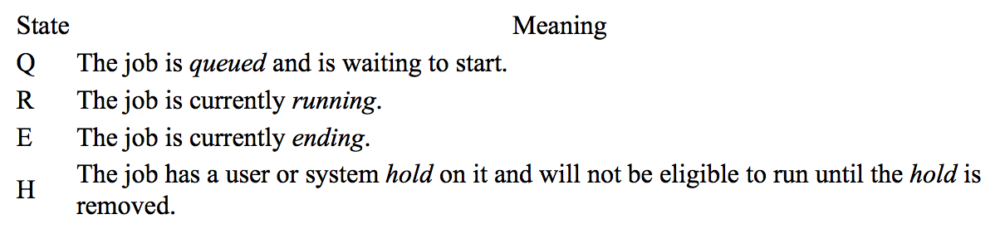
Task 1 : Run your first batch job
Step 3: Use the ‘qsub’ command to submit the job.
[vxm915@aci-lgn-006 BG_Retreat_2017]$ qsub first_batch_job.sh
Job will run under the 'open' account, as requested.
3681442.torque01.util.production.int.aci.ics.psu.edu
Step 4: Use the ‘qstat jobid' command to check the status of the job
[vxm915@aci-lgn-006 BG_Retreat_2017]$ qstat
Job ID Name User Time Use S Queue
------------------------- ---------------- --------------- -------- - -----
3681442.torque01.util.product first_batch_job vxm915 00:00:00 C open

Slide 15
Task 1 : Run your first batch job
Step 5: Make sure you received the following emails.
PBS Job Id: 3681314.torque01.util.production.int.aci.ics.psu.edu
Job Name: first_batch_job
Exec host: comp-sc-0309/0-1+comp-sc-0258/0,2
Begun execution
Error_Path: aci-lgn-006.acib.production.int.aci.ics.psu.edu:/storage/home/vxm915/BG_Retreat_2017/first_batch_job.out
Output_Path: aci-lgn-006.acib.production.int.aci.ics.psu.edu:/storage/home/vxm915/BG_Retreat_2017/first_batch_job.out
PBS Job Id: 3681314.torque01.util.production.int.aci.ics.psu.edu
Job Name: first_batch_job
Exec host: comp-sc-0309/0-1+comp-sc-0258/0,2
Execution terminated
Exit_status=0
resources_used.cput=00:00:00
.
.
req_information.hostlist.0=comp-sc-0309:ppn=2
req_information.hostlist.0=comp-sc-0258:ppn=2
req_information.task_usage.0.task.0={"task":{"cpu_list":"0,2","mem_list":"0","cores":0,"threads":2,"host":"comp-sc-0309"}}
req_information.task_usage.0.task.1={"task":{"cpu_list":"12,14,0,12","mem_list":"0","cores":0,"threads":4,"host":"comp-sc-0258"}}

Slide 16
Task 2 : Manage your job/process

Slide 17
Task 2 : Manage your job/process
Step 1: Update the time in the script ‘first_batch_job.pbs’ from 60 to 600.
Step 2: Resubmit the job.
#!/bin/bash
# Remarks: A line beginning with # is a comment.
# A line beginning with #PBS is a PBS directive.
# PBS directives must come first; any directives
# after the first executable statement are ignored.
##########################
# The PBS directives #
##########################
#PBS -l nodes=2:ppn=2 # Request nodes and processors per node
#PBS -l pmem=4gb # Request Memory
#PBS -A open # Allocation
#PBS -l walltime=04:00:00 # Specify time limit
#PBS -j oe # Merge the outputs into a single file
#PBS -o first_batch_job.out # Output file name
#PBS -N first_batch_job # Job name
#PBS -M emailid@psu.edu # Email ID for notification purposes
#PBS -m abe # Notification triggers
#################
# Bash commands #
#################
echo "Job Started"
sleep 600
echo "Job Ended”

Slide 18
Task 2 : Manage your job/process
Step 3: Use ‘qstat’ to get the job ID.
Step 4: Use the command ‘checkjob jobid’ to fetch job related information.
[vxm915@aci-lgn-006 BG_Retreat_2017]$ checkjob 3681535
job 3681535
AName: first_batch_job
State: Running
Creds: user:vxm915 group:vxm915 account:open class:open qos:open
WallTime: 00:00:00 of 4:00:00
SubmitTime: Thu Sep 14 17:05:40
(Time Queued Total: 00:00:19 Eligible: 00:00:19)
StartTime: Thu Sep 14 17:05:59
Job Templates: open,openacctnq
TemplateSets: DEFAULT,open.set,openacctnq.set
Total Requested Tasks: 4
Req[0] TaskCount: 4 Partition: pbs
Dedicated Resources Per Task: PROCS: 1 MEM: 4096M
NodeSet=ONEOF:FEATURE:[NONE]
Allocated Nodes:
[comp-bc-0108:2][comp-bc-0143:2]
Applied Nodeset: basic
SystemID: Moab
SystemJID: 3681535
Notification Events: JobFail Notification Address: emailid@psu.edu
IWD: $HOME/BG_Retreat_2017
StartCount: 1
Partition List: pbs
Flags: RESTARTABLE,SUSPENDABLE
Attr: checkpoint,open.set,openacctnq.set
Variables: UsageRecord=1030085
StartPriority: 1
IterationJobRank: 0
PE: 4.00
Reservation '3681535' (00:00:00 -> 4:00:00 Duration: 4:00:00

Slide 19
Task 2 : Manage your job/process
Step 5: Use ‘showstart jobid’ to check the start time and estimated completion time.
job 3681535 requires 4 procs for 4:00:00
Estimated Rsv based start in -00:08:44 on Thu Sep 14 17:05:59
Estimated Rsv based completion in 3:51:16 on Thu Sep 14 21:05:59
Best Partition: pbs
NOTE: job is running
Step 5: Try ‘qstat -n’
Step 6: Try ‘qstat -f’
Step 7: Use ‘qdel jobid’ to delete the job that us currently running
Step 8: Try ‘qdel $(qselect -u userid)’

Slide 20
Task 3 : Know your Cluster

Slide 21
Task 3 : Know your Cluster
Step 1: Use ‘pbsnodes’ to get the list of nodes in the cluster.
comp-clpc-0110
state = free
power_state = Running
np = 68
properties = proc68,xptcyberlamp,clphi,cyberlamp
ntype = cluster
status = opsys=linux,uname=Linux comp-clpc-0110.cylmp.hs.production.int.aci.ics.psu.edu 2.6.32-696.1.1.el6.x86_64 #1 SMP Tue Mar 21 12:19:18 EDT 2017 x86_64,nsessions=0,nusers=0,idletime=297958,totmem=206622708kb,availmem=202129556kb,physmem=198234104kb,ncpus=68,loadave=1.12,gres=,netload=4331396142,state=free,varattr= ,cpuclock=Performance:1401MHz,macaddr=3c:fd:fe:18:d3:80,version=6.1.1.1,rectime=1505499767,jobs=
mom_service_port = 15002
mom_manager_port = 15003
total_sockets = 1
total_numa_nodes = 1
total_cores = 68
total_threads = 68
dedicated_sockets = 0
dedicated_numa_nodes = 0
dedicated_cores = 0
dedicated_threads = 0

Slide 22
Task 3 : Know your Cluster
Step 2: The output is overwhelming. Let’s find the number of nodes that are part of this cluster using ‘pbsnodes | grep total_cores | wc -l’
Step 3: Choose a node that was assigned to your job in the prior step and search for it in the output. Use ‘pbsnodes | grep ‘node-name’
Working with Modules:
Step 4: Run the command ‘module spider’. it provides a list of packages that can be loaded and used.
Step 6: Run ‘module load python/2.7.8’
Step 7: Try ‘module load samtools/0.1.19’. Did it throw an exception?
Step 8: Try ‘module spider samtools/0.1.19’
Step 9: Use ‘module load gcc/5.3.1’ followed by ‘module load samtools/0.1.19’ Step 10: Try ‘module avail’

Slide 23
Task 4 : Invoke a python script

Slide 24
Task 4 : Invoke a python script
Step 1: Create a file with the name ‘calc_gc_content.py’ and paste the following script.
import sys
###################################################
# Assign the command line arguements to variables #
###################################################
source_location=sys.argv[1]
source_file=sys.argv[2]
input = open(source_location + source_file, 'r')
gc_content = []
###################################################
# Loop through the lines and calculate GC content #
###################################################
for line in input:
if line[0:1] != '>':
length = len(line)
gc_count = line.count('G') + line.count('C')
gc_content.append(round(float(gc_count)/float(length), 6))
print "The average GC content is :" + str(sum(gc_content)/len(gc_content))

Slide 25
Task 4 : Invoke a python script
Step 2: Create a pbs script file with the name ‘first_mod_job.pbs’ and paste the following commands. Modify the locations defined by variables DATA_SOURCE_DIR and PYTHON_SCRIPT_DIR
#!/bin/bash
##########################
# The PBS directives #
##########################
#PBS -l nodes=2:ppn=2 # Request nodes and processors per node
#PBS -l pmem=4gb # Request Memory
#PBS -A open # Allocation
#PBS -l walltime=04:00:00 # Specify time limit
#PBS -j oe # Merge the outputs into a single file
#PBS -o first_mod_job.out # Output file name
#PBS -N first_mod_job # Job name
#################
# Bash commands #
#################
DATA_SOURCE_DIR='/storage/work/userid/BG_Retreat_2017/'
PYTHON_SCRIPT_DIR='/storage/home/userid/BG_Retreat_2017/'
SOURCE_FILE='sg11_all_chromosomes.fa'
echo "Job started on `hostname` at `date`"
module load python/2.7.8
python ${PYTHON_SCRIPT_DIR}/calc_gc_content.py ${DATA_SOURCE_DIR} ${SOURCE_FILE} > calc_gc_content_py.out
echo "Job ended on `hostname` at `date`"

Slide 26
Task 4 : Invoke a python script
Step 2: Submit the script using ‘qsub first_mod_job.pbs’
Step 3: Wait for the output files first_mod_job.out and calc_gc_content.py
Step 4: Run ‘cat calc_gc_content.py’ to view the output of the python script

